Slide 1
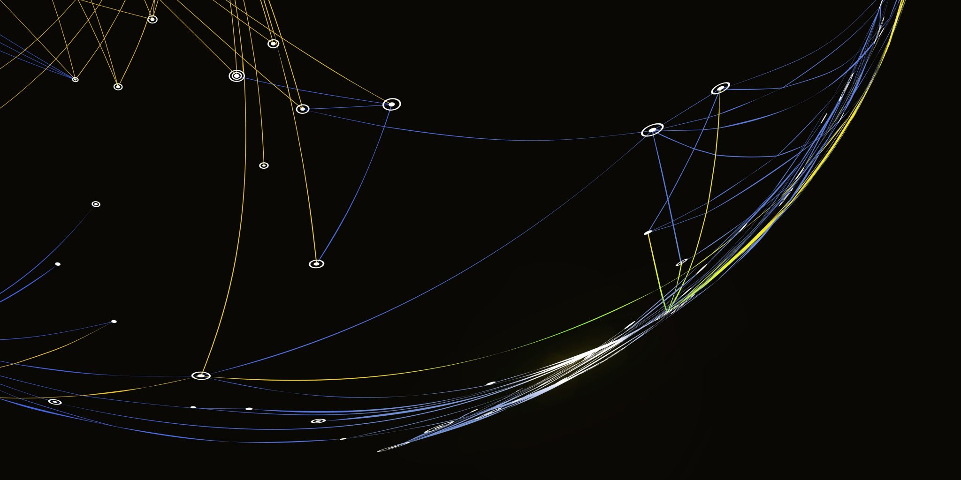

Autotuning System For String Instruments
ELL205 Course Project
Prof. Abhishek Dixit
Mentors- Shivam Kumar, Bhavya Kalani, Isha Chauhan
Group Members –
1.Ishaan Govil
2.Tushar Gujral
3.Shivam Jain

Slide 2


INTRODUCTION
The project is aimed at determining the tuning stage (under-tuned / over-tuned) of any string instrument like guitar, violin etc. This is a problem that is frequently encountered by both trained musicians and common people as they need to work with different instruments and even in the case of the same instrument the tension of the guitar string changes subject to the temperature conditions and other factors which lead to length expansion or contraction of strings.
Hence, by developing a model which can predict the over-tuning and under-tuning of a musical instrument we can help the instrumentalists with no longer needing to use their own ears to guess the under-tuning and over-tuning of the instrument which is often misleading.

Slide 3
METHODOLOGY
Plotting the Frequency Spectrum and finding the fundamental frequency
Sampling
Fourier Transform using FFT
Calculating and Normalizing the absolute values of the Transform
Conversion into a single sided signal
Plotting the spectrum
Locating the peaks
Finding the Fundamental Frequency

Slide 4
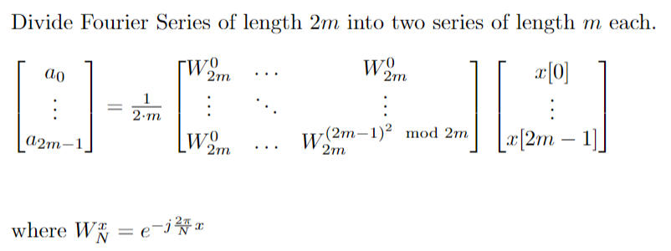
Fast Fourier Transform
The FFT algorithm (Divide and Conquer)

Slide 5
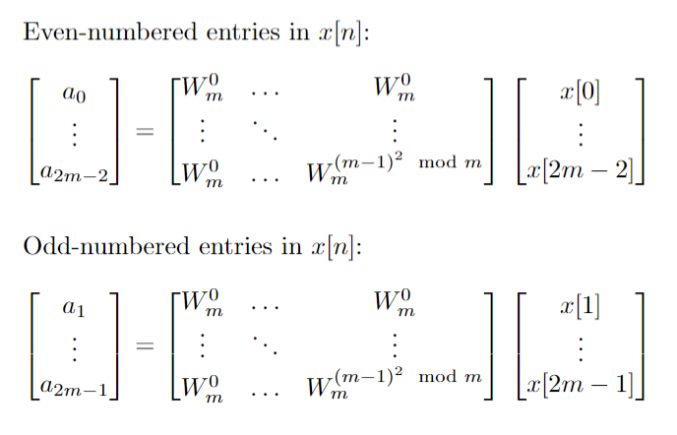

Slide 6
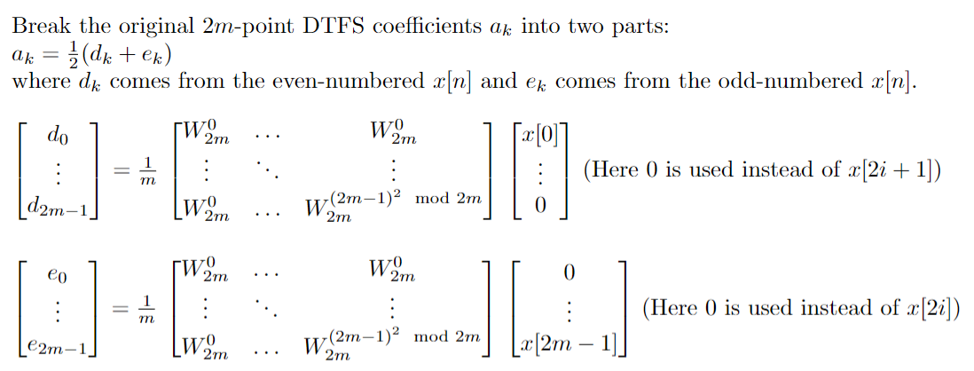

Slide 7
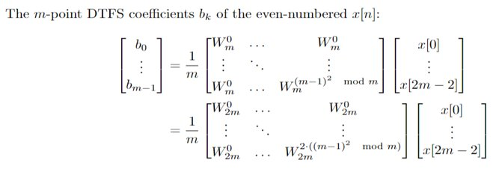
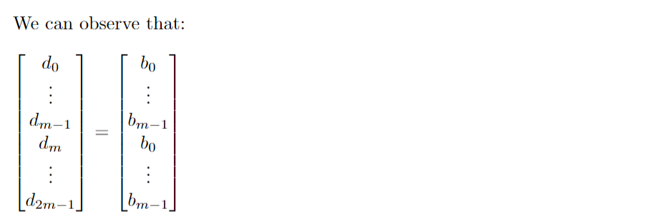

Slide 8
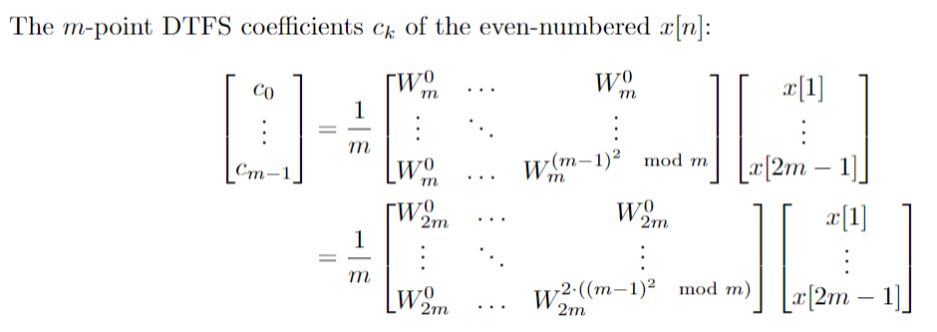
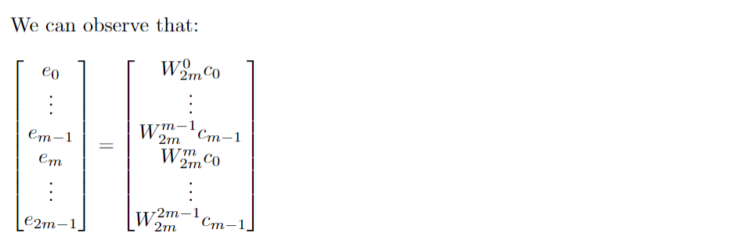

Slide 9
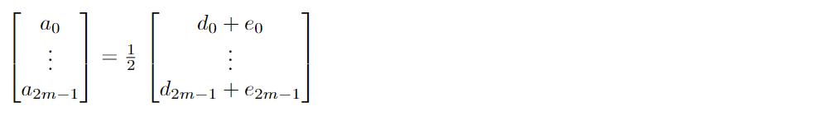
Time Complexity
Let N(n) be the number of arithmetic operations to compute n-point FFT (Here n = 2^k, k <= 0)
N(1) = 0
N(2) = 2 N(1) + 6
….
N(n) = 2 N(n/2) + 3n
=> N(n) = O(n log n)
Thus, time-complexity is reduced significantly by using FFT instead of conventional matrix multiplication.

Slide 10

SAMPLE AUDIOS AND THEIR RESULTS

Slide 11

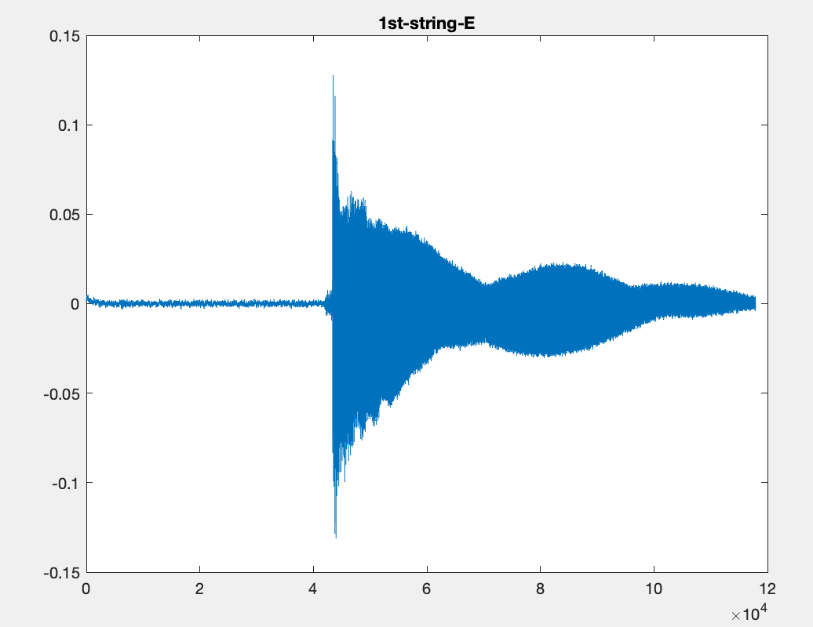
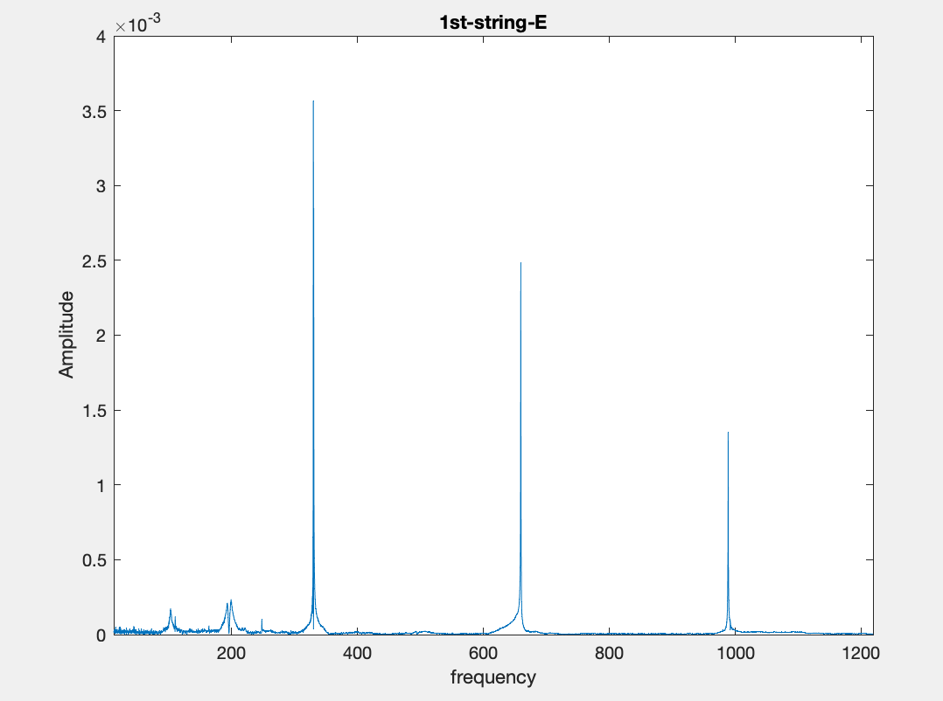
1st String E₄
Fundamental Frequency – 329.68 Hz

Slide 12
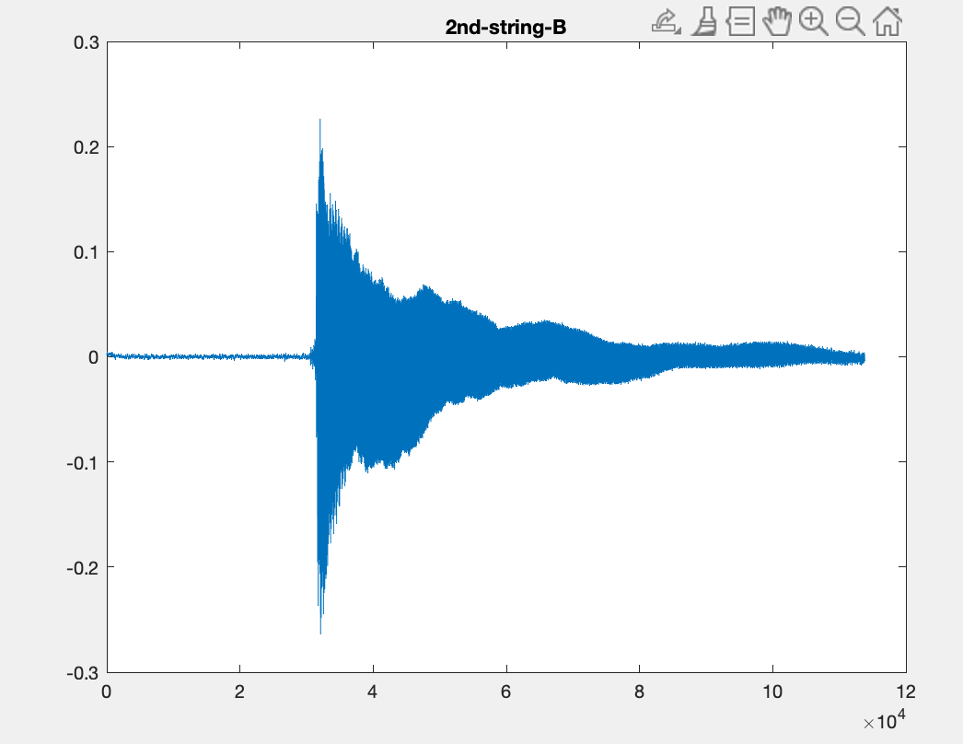
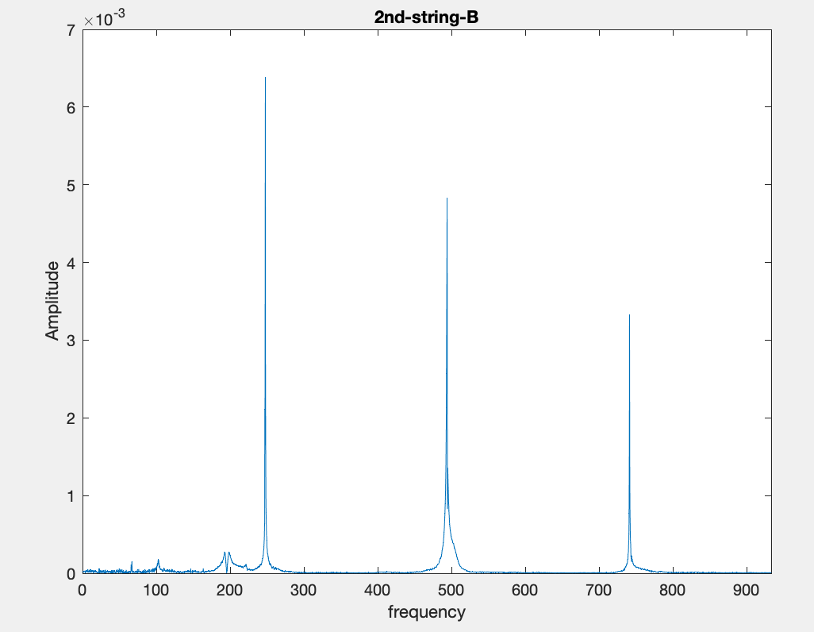
2nd String B₃
Fundamental Frequency - 247.97 Hz

Slide 13
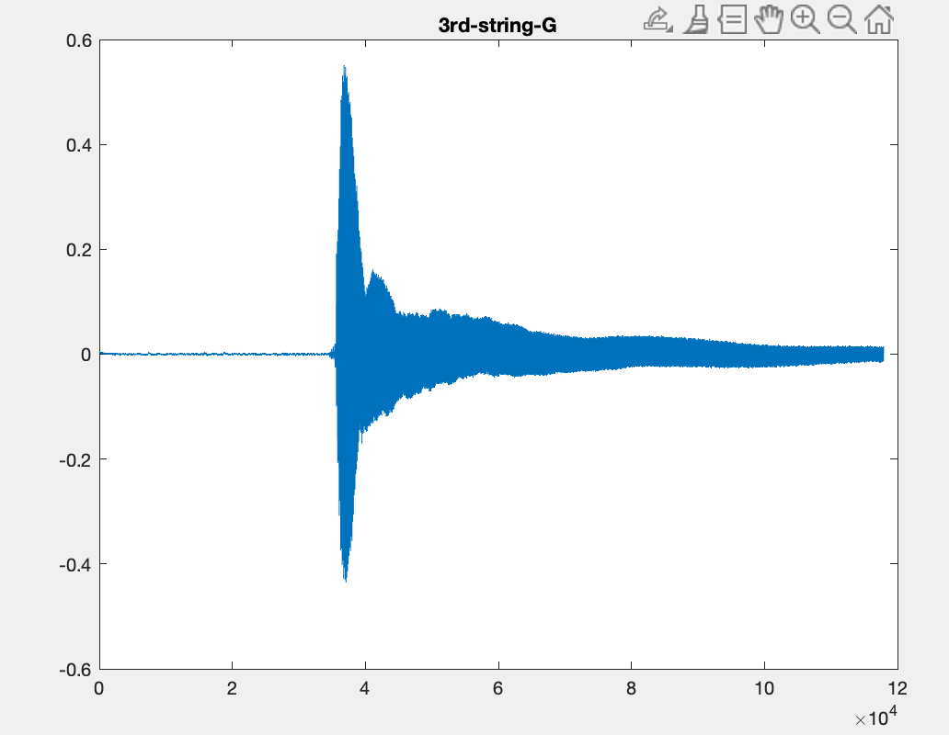
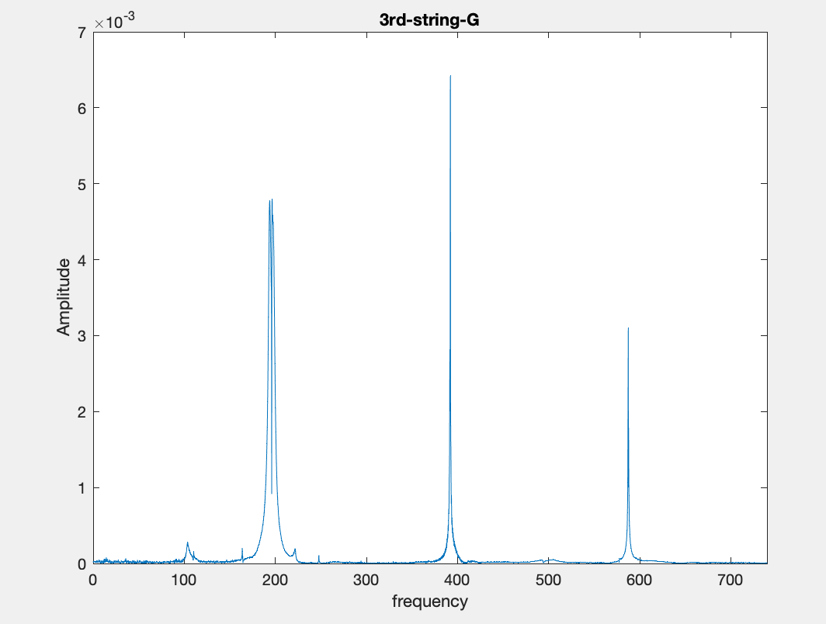
3rd String G₃
Fundamental Frequency – 196.72 Hz

Slide 14
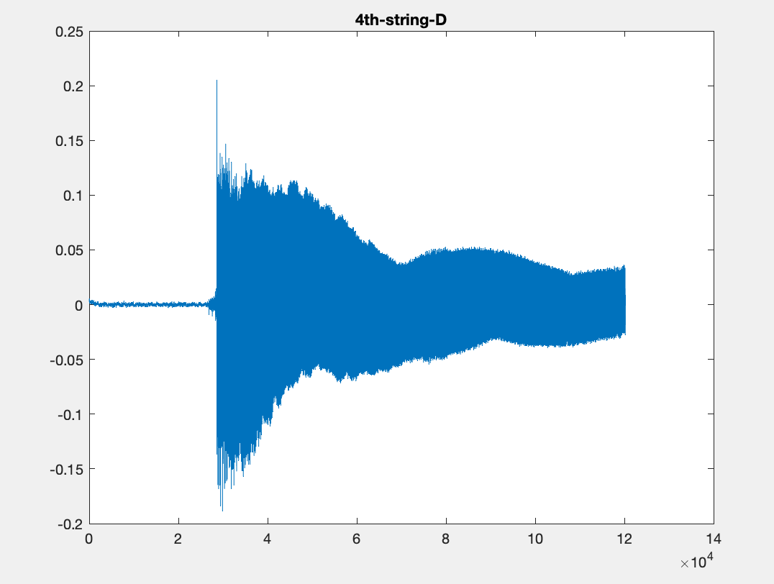
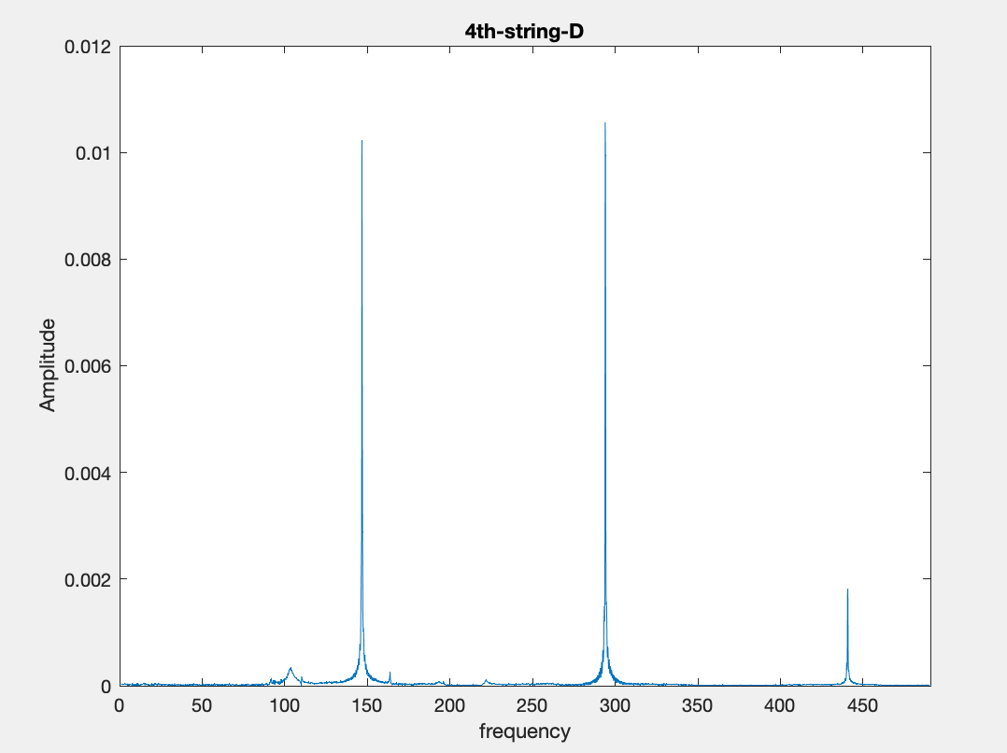
4th String D₃
Fundamental Frequency – 146.88 Hz

Slide 15
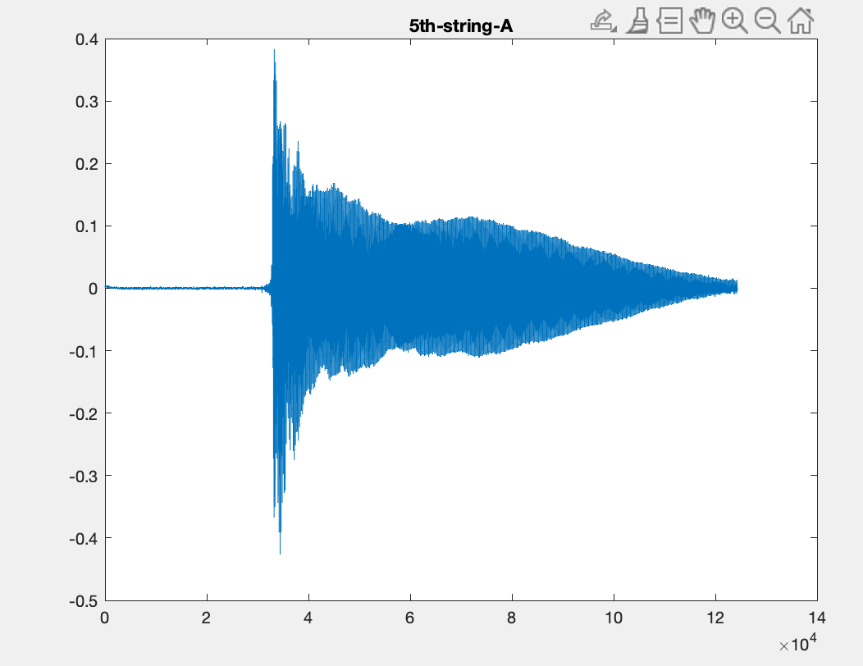
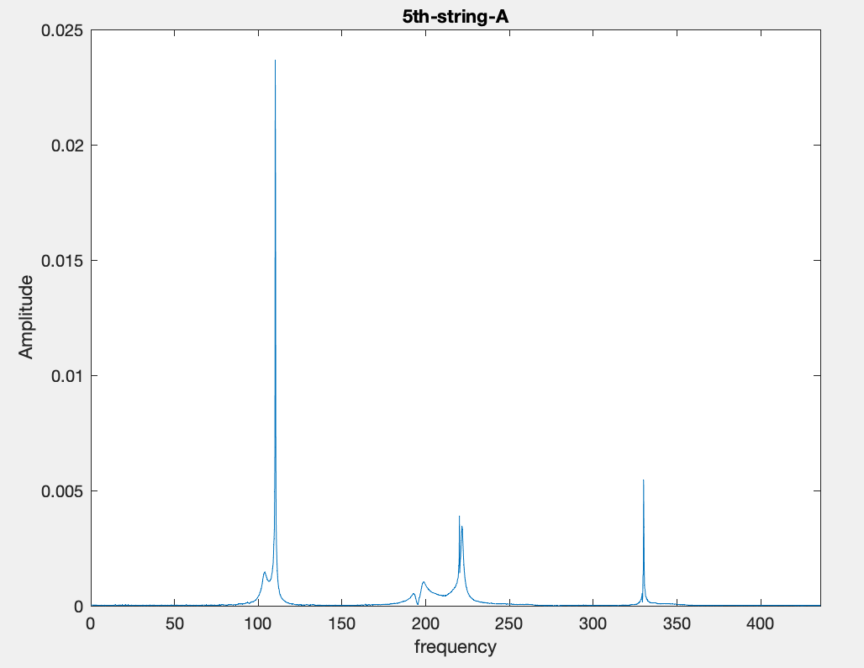
5th String A₂
Fundamental Frequency – 110.29 Hz

Slide 16
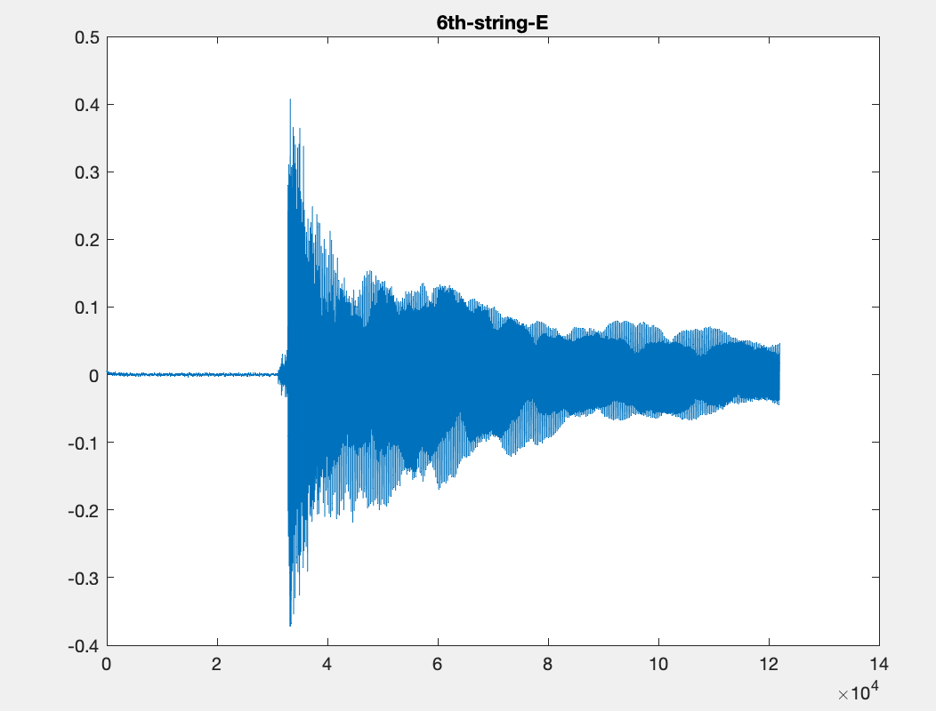
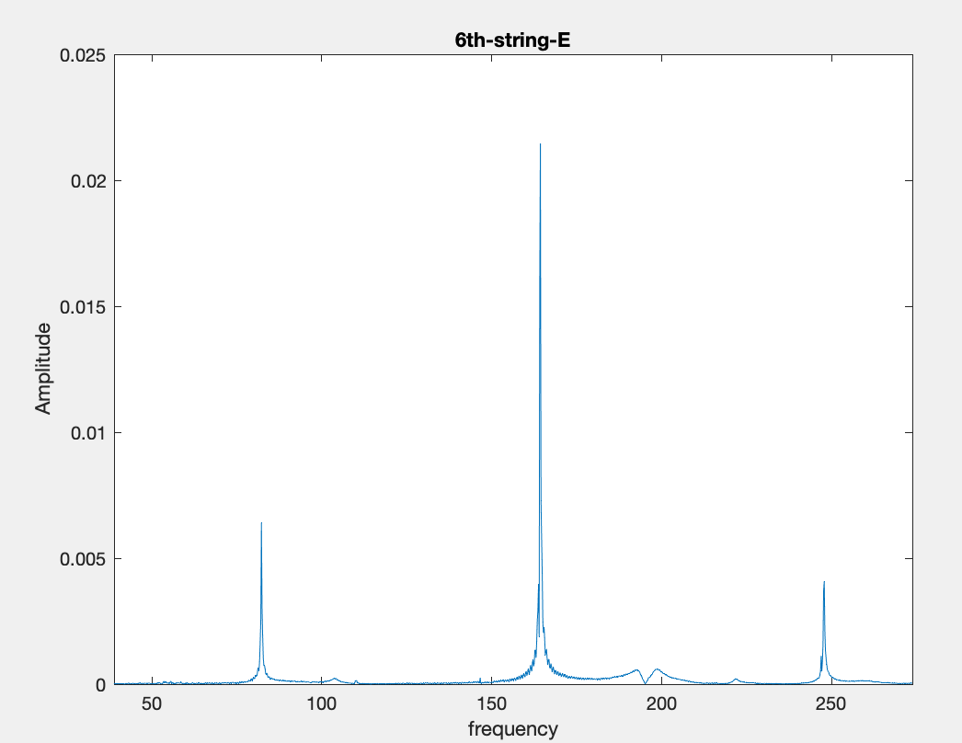
6th String E₂
Fundamental Frequency – 82.41 Hz

Slide 17
DEMO
Test audio 1 (under-tuned) String 1E -
Test audio 2 (fine-tuned) String 5A –
Test audio 3 (over-tuned) String 5A -

Slide 18
THANK YOU

